Slide 1
Welcome to Year 3 and 4 Meet the Teacher

Slide 2
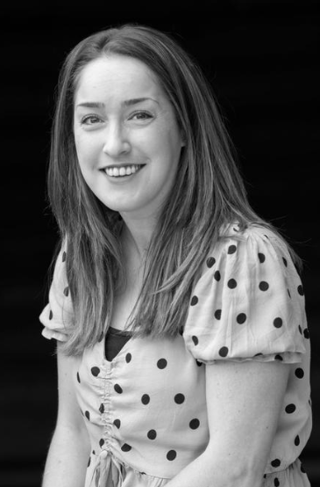
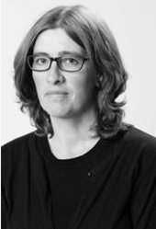
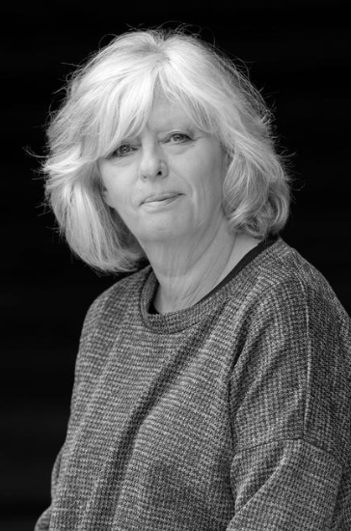
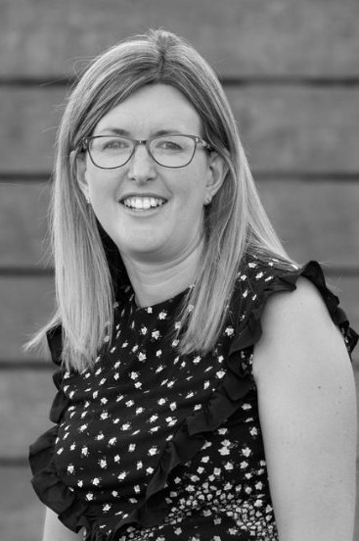
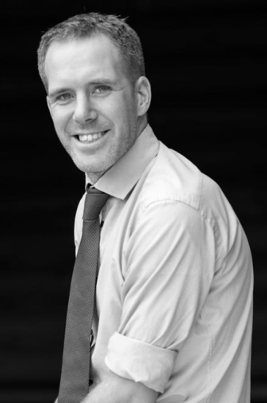
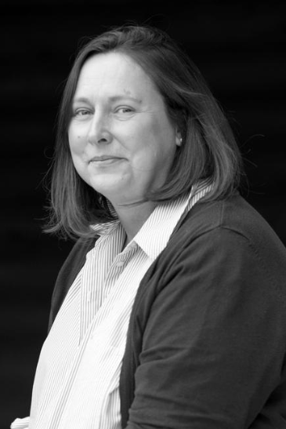
Adults we work with…
Year 3
Year 4
Miss Newns: CT (Mon-Fri)
Mrs Wood TA: (Mon-Thurs)
Mrs Lochhead: TA (Tues & Wed)
Ms Adams: TA and Cover (Wed & Thurs)
Mrs Bruce: Cover (Thurs)
Mrs Pollard CT (Tues-Fri)
Mr Cook CT (Mon & Wed pm)
Mrs Bennett TA (Mon-Wed)
Mrs Higginson – (Thurs)
Mrs Lochhead TA (Thurs)
Mrs Wood TA (Fri)
Miss Floyd (Mon-Wed)

Slide 3
A typical day in Year 3 and Year 4:

Slide 4
Year 3 Learning:
History – Stone Age
Geography - Volcanoes
Life in the Stone Age.
Skara Brae and Stone Henge.
Who was the Amesbury Archer?
Iron Age and Bronze Age.
Artefacts.
Hunter gathering.
How the earth is constructed.
Mountains.
Volcano formation.
Volcanic eruptions.
Earthquakes.
Types of rocks.

Slide 5
Year 4 Learning:
History – How have children’s lives changed?
Geography – Why are rainforests important to us?
Why did Tudor children work and what was it like?
What were children’s jobs like in Victorian England?
How did Lord Shaftesbury help to change the lives of children?
How and why has children’s leisure time changed?
What were the diseases children caught and how were they treated?
Where in the world are tropical rainforests?
What is the Amazon rainforest like?
Who lives in the rainforest?
How are rainforests changing?
How is our local woodland used?

Slide 6
PE Lessons
Year 3 PE day = Monday
Year 4 PE days = Mondays and Thursdays
Correct clothing in line with school uniform policy – shorts, joggers, house team coloured t-shirt, trainers/plimsolls.
Socks.
No earrings.

Slide 7
Reading Expectations…
Reading record – checked regularly over the week.
Adult or child to record (e.g. independent reading).
10 mins each day.
Housepoints for reading.
Bug Club.
Responsible for changing their book.
Assessments throughout the year.

Slide 8
Spellings…
Year ¾ statutory word list (split between year groups).
Spelling rules.
Spelling test each week.
Continue using and applying phonics.
Edshed.
Spelling journal and spelling fluency books in school.

Slide 9
Spelling Arrangements…
New spellings handed out on Friday in red spelling book.
Practised throughout the week at home and school.
Tested on Thursday – BRING BOOK BACK!
Marked ready for new spellings to be handed out.

Slide 10
Home Learning…
Reading 5x week.
Spellings in red book.
Edshed spellings assignment.
Times Tables Rockstars.
Home learning grid.

Slide 11
Uniform…
Black/blue/grey trousers/skirts.
White polo/shirt.
Navy/blue cardigan or jumper.
Grey, navy, black or white socks.
Black school shoes.
Earrings – small studs that must be removed by child for PE.
Long hair (shoulder length and below) must be tied back at all times, hair ties and headbands should be small and discreet in school colours only.
Children should not wear make up, nail polish or temporary tattoos in school.
Please ensure that ALL uniform and equipment is named.

Slide 12
Communication
Please email info@dormansland.surrey.sch.uk with subject as FOA: ‘teacher name’
We will then get in touch with you at the earliest opportunity.
We are always available on the playground at the end of the school day once the class has been dismissed.
For small non-urgent matters, notes could be put in the reading diaries.
Please also check messages on the class webpages, SCOPAY, Marvellous Me and school newsletters.

Slide 13
Others…
Parent readers.
Pieces of fruit or plain breadsticks for snack.
Equipment.
Permission slips, medical and collection arrangements.

Slide 14
Any Questions?

